Slide 1
Lane Detection
Li Huang
10/25/2016

Slide 2
Outline
Project Description/Requirements
Detect the lanes in the video and mark them with red lines
Implementation
Perspective transformation
Edge detection with LoG operator
Hough Line Detection
References

Slide 3
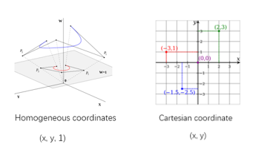



Perspective transformation
The viewpoint in the source image is 'looking' at the scene from an angle. After Perspective transformation, the destination image has moved the viewpoint so it is facing into the scene.
Source image
Destination image
Any point in the projective plane is represented by a triple (X, Y, Z), called the homogeneous coordinates or projective coordinates of the point, where X, Y and Z are not all 0.
When Z is not 0 the point represented is the point (X/Z, Y/Z) in the Euclidean plane. （Cartesian coordinate）

Slide 4
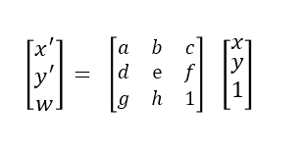




Perspective transformation matrix
The perspective transform is represented by a 3 x 3 matrix that transforms homogenous source coordinates (x, y, 1) into destination coordinates (x', y', w). To convert back into non-homogenous coordinates, x' and y' are divided by w.
From the equation we can get
Then the $x′$ and$y′$ and be express as
$$w=gx+hy+1$$
$$x′=\frac{ax+by+c}{gx+hy+1}$$
$$y′=\frac{dx+ey+f}{gx+hy+1}$$

Slide 5
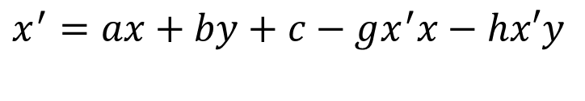

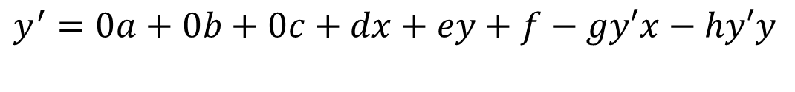
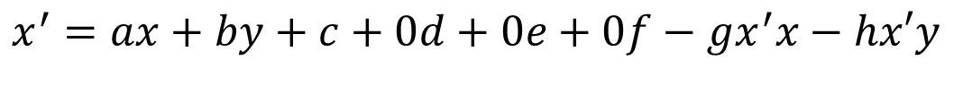
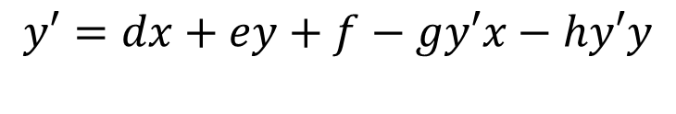
By multiplying each side of the equation by the denominator and isolate naked $x^{′}$ and $y^{′}$ we get:
If we add in some zero terms,
Then it becomes the product of a matrix and a vector,
$\left[\begin{matrix}x & y & 1 & 0 & 0 & 0 & {−x}^{′}x & −x^{′}y \\ 0 & 0 & 0 & x & y & 1 & −y^{′}x & −y^{′}y\end{matrix}\right]\left[\begin{matrix}a \\ b \\ c \\ d \\ e \\ f \\ g \\ \begin{aligned}h \\ 1\end{aligned}\end{matrix}\right]=\left[\begin{matrix}x^{′} \\ y^{′}\end{matrix}\right]$
$$x^{′}=ax+by+c−gx^{′}x−hx′y$$
$$y′=dx+ey+f−gy′x−hy′y$$
$$x^{′}=ax+by+c+0d+0e+0f−gx^{′}x−hx′y$$
$$y^{′}=0a+0b+0c+dx+ey+f−gy′x−hy′y$$

Slide 6

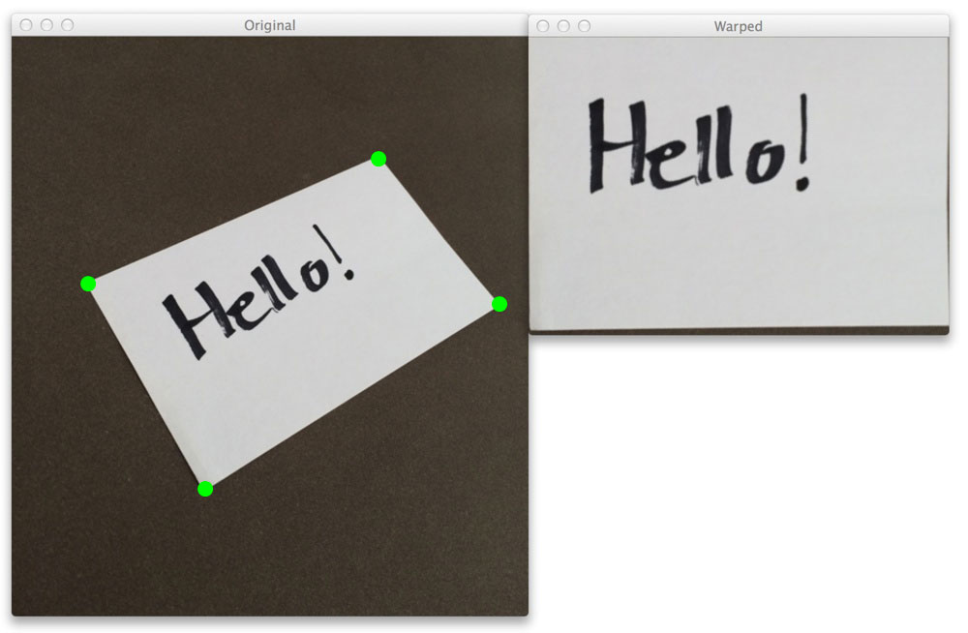

Get four points of the original image (x1,y1), (x2,y2), (x3,y3), (x4,y4).
Calculate the corresponding points’ coordinate after transformation (${x1}^{′},y1′$), (${x2}^{′},y2′$), (${x3}^{′},y3′$), (${x4}^{′},y4′$).Here I use the rectangular shape.
Substitute the sixteen numbers into the matrix equation and we can get the value of the vector$\left[\begin{matrix}a \\ b \\ c \\ d \\ e \\ f \\ g \\ \begin{aligned}h \\ 1\end{aligned}\end{matrix}\right]$ , then we can get the transform matrix
Loop through the whole image, by multiplying
the pixels coordinate with the transform matrix,
we get the perspective coordinate of every pixel.

Slide 7
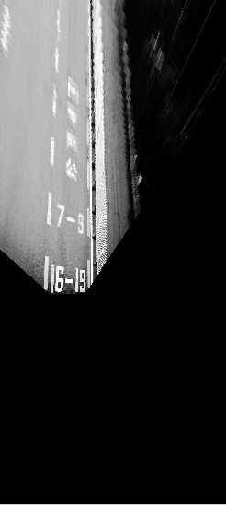
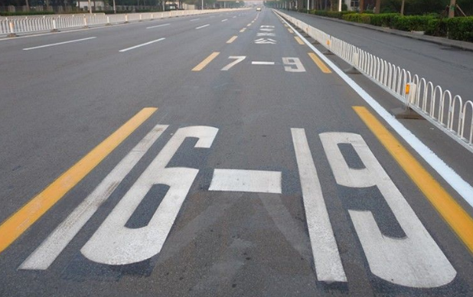
Obtaining a Top-Down View of the Image

Slide 8

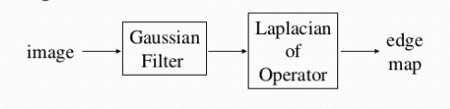
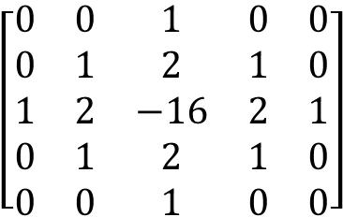
Laplacian of Gaussian (LoG) Edge Detection
The Laplacian method searches for zero crossings in the second derivative of the image to find edges.
Laplacian of Gaussian (LoG) edge detection method requires the following steps:
1. Convolve the image with a Gaussian Smoothing filter
2. Convolve the image with a Laplacian mask
$$\left[\begin{matrix}0 & 0 & 1 & 0 & 0 \\ 0 & 1 & 2 & 1 & 0 \\ 1 & 2 & −16 & 2 & 1 \\ 0 & 1 & 2 & 1 & 0 \\ 0 & 0 & 1 & 0 & 0\end{matrix}\right]$$

Slide 9
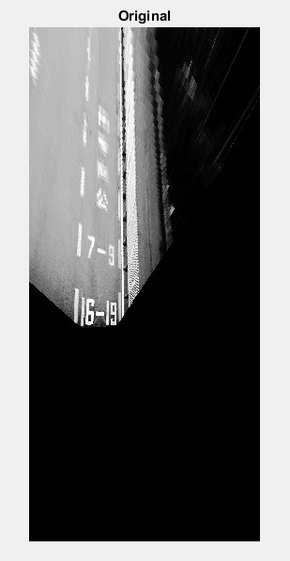
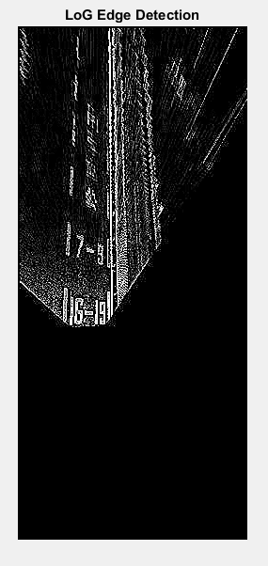
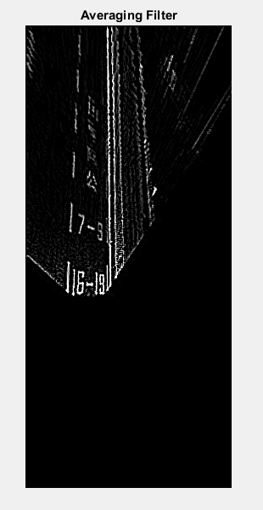

Slide 10
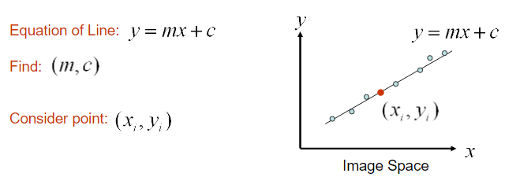
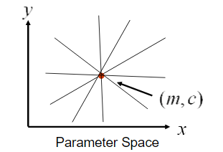
Hough Line Detection
Every point in the Image Space corresponds to a line in the parameter space. The point where the lines intersect in the parameter space gives an m and a c.

Slide 11
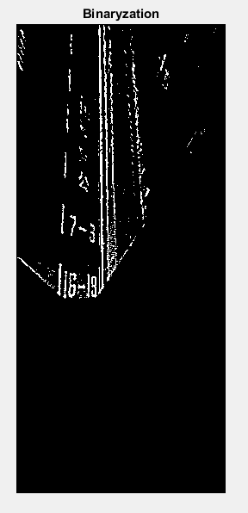
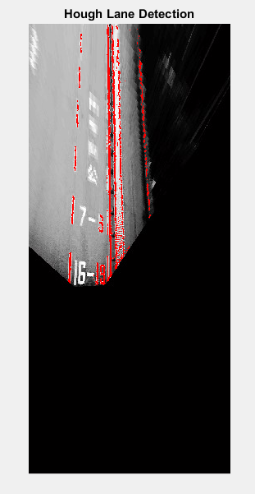

Slide 12
Reference
A Fast Hough Transform Algorithm on Lane Detection—Kang Kang
2.Lane Detection based on Edge Detection and Hough Transform—Yueqin Ni
3. https://en.wikipedia.org/wiki/Hough_transform
4. Perspective Transformation http://blog.csdn.net/xiaowei_cqu/article/details/26471527
5. Laplacian/Laplacian of Gaussian http://homepages.inf.ed.ac.uk/rbf/HIPR2/log.html

